Slide 2
Showww Me The Revenue
How AI is improving healthcare

Slide 3
Joseph Travagline MS, RHIA
System Director of Practitioner Credentialing (CVO)
Director of Medical Staff Services
- Montgomery Medical Center
MedStar Health System

Slide 4
Located in Maryland and Washington DC region,
MedStar Health has more than 300 care locations.
10 Hospitals
MedStar Georgetown University Hospital (Academic)
MedStar Washington Hospital Center (Academic)
MedStar Franklin Square Medical Center
MedStar Good Samaritan Hospital
MedStar Harbor Hospital
MedStar Montgomery Medical Center
MedStar National Rehabilitation Hospital
MedStar Southern Maryland Hospital Center
MedStar St. Mary's Hospital
MedStar Union Memorial Hospital
CVO
Currently, Manages all hospital credentialing and recredentialing ~5400 practitioners

Slide 6
Notes:
Blockchain and artificial intelligence (AI) are two distinct technologies, but they can complement each other in various ways.
Here are some key points about the relationship between blockchain and AI:
Data Security and Privacy, Data Quality and Trust, Decentralized Data Marketplaces, AI in Blockchain Analytics, Smart Contracts and Automation, Decentralized AI Networks:, Tokenization and Incentives, Challenges and Scalability, Regulatory Considerations, Emerging Use Cases

Slide 8
Notes:
While blockchain and AI can complement each other, it's essential to note that combining these technologies can be complex, and their successful integration depends on specific use cases and the goals of the application. Additionally, both blockchain and AI have their own challenges and limitations that need to be considered when using them together.

Slide 9
What is AI?
What is AI?
WHY DO I CARE?

Slide 10
Definition of AI
AI is a branch of computer science that deals with the development of machines that can perform tasks that typically require human intelligence such as visual perception speech recognition decision-making and language translation.
Additional definitions:
Building intelligent entities or agents
Making computers think or behave like humans
Studying the human thinking through computational models
Generating intelligent behavior, reasoning, learning.
Goal of AI:
Create machines that mimic human thoughts

Slide 11
History of AI
1950: Mathematician and Scientist Alan Turing wrote a paper titled "Computing Machinery and Intelligence." Developed a test to determine if a machine could exhibit human-like intelligence.
1956 – John McCarthy organized a workshop at Dartmouth where the name of AI was officially adopted for the field and he coined the phrase Artificial Intelligence.
The early systems were successful on small problems but failed on larger ones.
Notes:
The concept of the Turing Test has since inspired various competitions and experiments, often referred to as Turing Test-like evaluations, where AI systems are assessed based on their ability to engage in conversation. These tests have been conducted in different forms, but the original Turing Test itself, as Turing described it in his 1950 paper, was a theoretical concept rather than an immediate practical experiment.

Slide 12
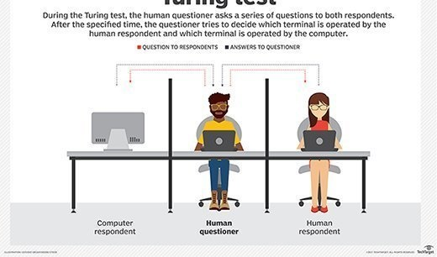
Turing Test
Human vs Computer
Notes:
The concept of the Turing Test has since inspired various competitions and experiments, often referred to as Turing Test-like evaluations, where AI systems are assessed based on their ability to engage in conversation. These tests have been conducted in different forms, but the original Turing Test itself, as Turing described it in his 1950 paper, was a theoretical concept rather than an immediate practical experiment.

Slide 13
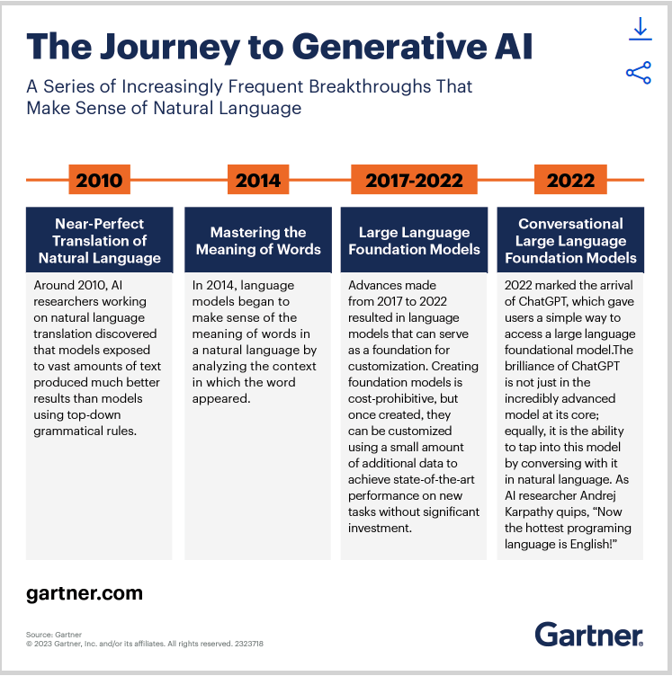
Generative AI
Focuses on creating or generating new content, data, or information. It involves using AI models and algorithms to produce content that is often creative, realistic, or useful. Generative AI applications include Text Generation, Image Generation, Music and Sound Generation, Data Augmentation, and Drug Discovery.
Other names that AI goes by
Machine Intelligence
Cognitive Computing
Intelligent Automation
Machine Learning
Deep Learning
Neural Networks
Natural Language Processing (NLP)
Computer Vision
Robotics
Autonomous Systems
Expert Systems
AI Assistants
Strong AI
Weak AI
Machine Perception
Notes:
Artificial Intelligence (AI) is sometimes referred to by alternative terms or variations, depending on the context and the specific focus of the technology or application. Here are some other names and related terms for AI:
The word "generative" has its origins in the Latin language. It is derived from the Latin verb "generare," which means "to generate" or "to produce." In Latin, "generare" is related to the noun "genus," which means "birth," "origin," or "kind."

Slide 14
Why do we need AI?
What is AI?
WHY DO I CARE?

Slide 16
Cleared more than 500 healthcare AI algorithms
Created an open database for AI algorithms
HIMSS conference, AI was seen across many of the 1,400 vendors.
Key areas for non-clinical AI is being implemented:
Revenue cycle management streamlining
Managing Medical Records and Other Data
Doing Repetitive Jobs
Population health
Health tracking apps
Identifying and addressing gaps in health equity
Hospital-wide monitoring include:
Length of stay
Bed turn over rates
Early sepsis detection and readmissions
Data analytics for key performance indicators
Enabling better patient wellness and preventative care
Health tracking apps to better monitor patient health
Identifying people who may require physical follow up
Breakdown of FDA-cleared algorithms
across specialties:
396 Radiology
58 Cardiology
14 Hematology
10 Neurology
7 Clinical chemistry
7 Ophthalmic
5 Gastroenterology & Urology
5 General & Plastic Surgery
4 Pathology
4 Microbiology
4 Anesthesiology
4 General Hospital
1 Orthopedic
1 Dental

Slide 17
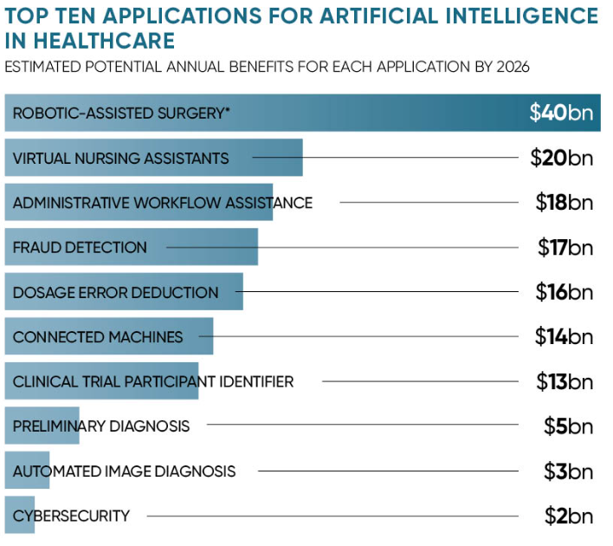
Showing you the Money
AI’s impact on healthcare is to automate administrative
tasks. It is expected that this could result in $18 billion
in savings for the healthcare industry as machines can
help save time on administrative tasks.

Slide 18
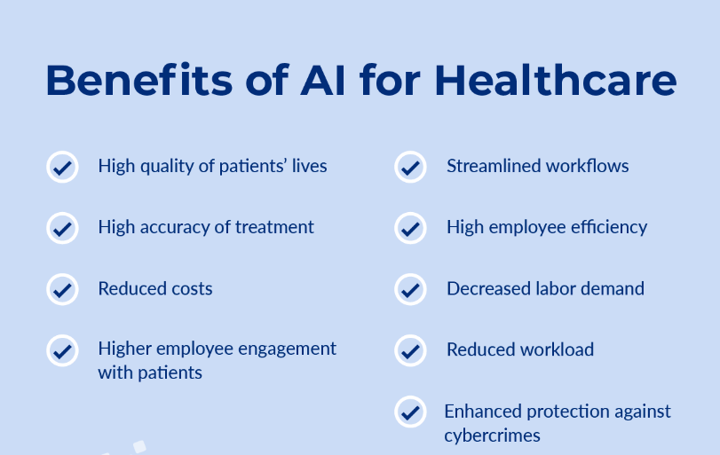

Slide 19
It’s Not Your Grandma’s CVO
What is AI?
WHY DO I CARE?

Slide 20
It’s time to reimagine the CVO
Get Rid Of:
Paper Applications
Faxing
Emailing Fillable PDF’s
Printing Documents for Signatures
Missed Practitioner Engagement
Time to revenue missed
Need to be more then just credentialing.
Need to be the source of truth for all practitioner data.
Need to be provider enrollment
Need to be onboarding
Need to remove practitioner burden
Need to engage IT resources and embed them in processes
Need to rebrand the CVO:
“PRACTITIONER SOLUTION CENTER”

Slide 21
Credentialing Opportunities
Moving into a new frontier
Opportunities:
Automated Data Extraction
Credential Verification
Continuous Monitoring
Document Classification and Organization
Time Efficiency
Fraud, Waste, and Abuse Detection
Data Accuracy and Consistency
Decision Support
Machine Learning for Risk Assessment
Integration with Healthcare Systems
Routine tasks i.e. data entry
Human oversight is still critical
Not a replacement for the judgment and decision-making of experienced credentialing professionals.

Slide 22
PRACTITIONER SOLUTION CENTER
NUMBER ONE GOAL REMOVING PRACTITIONERS BURDEN
ONE STOP SHOP FOR ALL ANSWERS
Includes Administrative Tasks:
Onboarding
Practitioner Engagement
Hospital Credentialing/Recredentialing
Privileging
Payor Credentialing
Enrollment (Government and Commercial)
System setup and access
Integration
Data management
Compliance reporting
Medical Staff Office Support
Many, many, more opportunities…..

Slide 23
Artificial Intelligence Implementation
Criteria for Success:
Big picture considerations first
Guardrails
Ethical use
Policies & Procedures
Best practices
Training sensitive data tools
Planned usage
Vendor agreements
Business model
Tracking regulations and use of AI
Compliance
Similar to any other new technology…..
- Remember what happened when everyone had a cell phone
"Hospital IT departments are woefully unprepared for this onslaught of AI“
- Julius Bogdan, VP and General Manager HIMSS Digital Health Advisory Team

Slide 24
Artificial Intelligence Implementation
Criteria for Success:
Big picture considerations first
Guardrails
Ethical use
Policies & Procedures
Best practices
Training sensitive data tools
Planned usage
Vendor agreements
Business model
Tracking regulations and use of AI
Compliance
Similar to any other new technology…..
- Remember what happened when everyone had a cell phone

Slide 25
AI Headlines the Good
What is AI?
WHY DO I CARE?

Slide 26
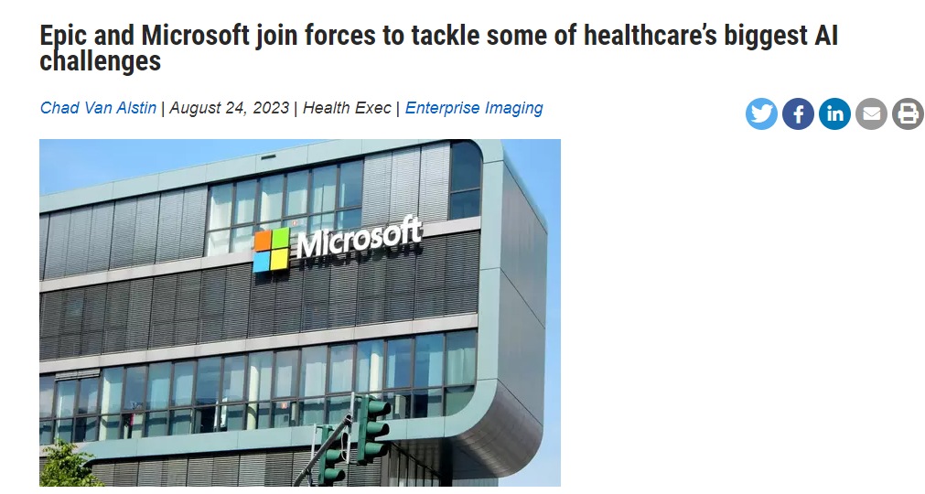
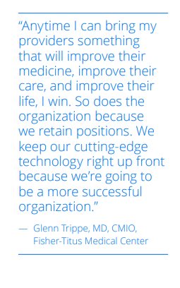
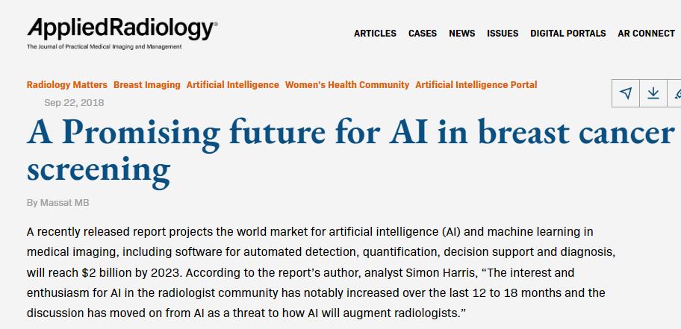
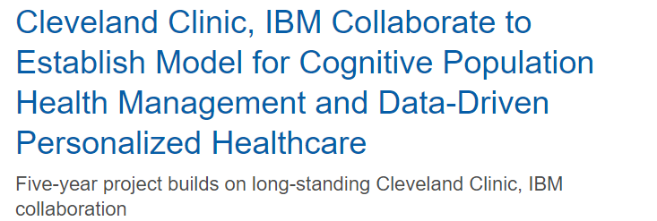
Notes:
Microsoft and Epic seem to be focused on how AI can improve care delivery. clinical insights and administrative tools across various Epic modules, promising a holistic transformation of healthcare practices.
The companies' ultimate goal is to streamline workflows, improve patient care delivery and bolster the efficiency of healthcare systems on a global scale – and its impact could be seen everywhere, considering Epic is used in 36 percent of U.S. hospitals. alleviate much of the clerical burden that contributes to physician unhappiness.
UK 13M equals 16 billion US dollars

Slide 27
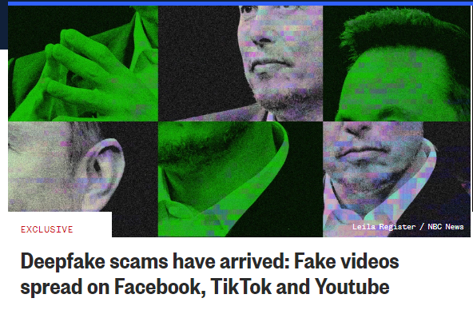
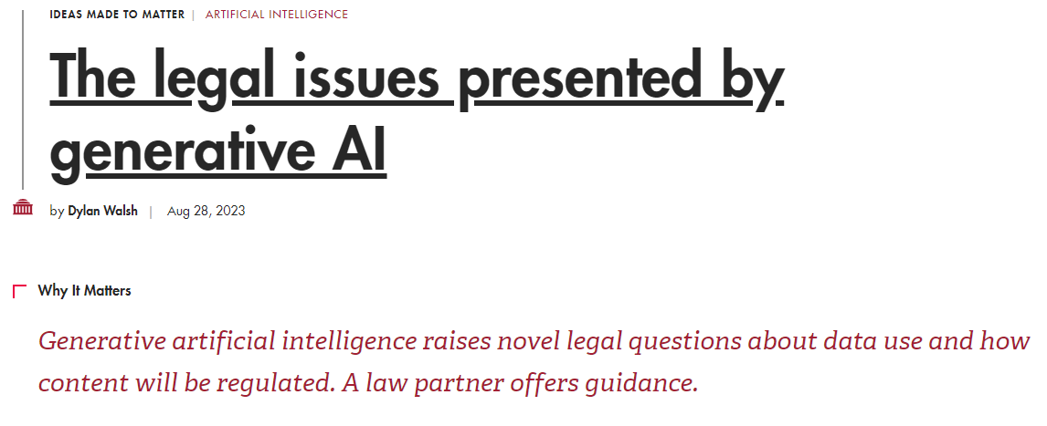
AI Headlines the Ugly

Slide 28
The Bottom Line
WHY DO I CARE?

Slide 29
The Bottom Line
AI is here to stay
Need to overcome Fear Factor
Reduces Human Error
Boost Outcomes
Improves Access
Data Privacy Challenges
Improves ROI
In medicine there is no universal method for all applications of AI, instead a large number of possible solutions for everyday problems no matter the size.
Notes:
While advancements like these can reduce human error and boost overall outcomes and consumer trust, many still question the practical applicability of AI in health care. Patients and caregivers alike fear that lack of human oversight and the potential for machine errors can lead to mismanagement of care, while data privacy remains one of the biggest challenges to AI-dependent health care.
Despite such concerns, the growing involvement of AI in health care is inevitable. But as these advancements suggest, the potential benefits might just outweigh the risks.

Slide 30
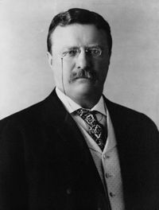
“It is not the critic who counts; not the man who points out how the strong man stumbles, or where the doer of deeds could have done them better. The credit belongs to the man who is actually in the arena, whose face is marred by dust and sweat and blood; who strives valiantly; who errs, who comes short again and again, because there is no effort without error and shortcoming; but who does actually strive to do the deeds; who knows great enthusiasms, the great devotions; who spends himself in a worthy cause; who at the best knows in the end the triumph of high achievement, and who at the worst, if he fails, at least fails while daring greatly, so that his place shall never be with those cold and timid souls who neither know victory nor defeat.”
― Theodore Roosevelt

